Slide 1
HARVESTING ROBOT
By
Ms.Shaik Shalina 14471A0437
Ms.Shahina Siddiqua Banu 14471A0420
Mr.Syed Mansoor 14471A0438
Ms.Yarasingu Sita Devi 14471A0418
Ms.Tanuboddi Ramya Krishna 14471A0429
Guide: Dr. V. Venkata Rao.

Slide 2
CONTENTS
Aim
Existing Methods
Proposed Method
Block Diagram
Results
Conclusion
Future Scope
References

Slide 3
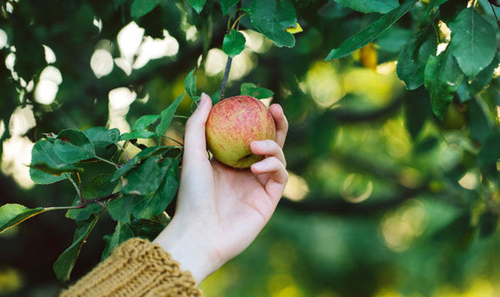
AIM
The main aim of this harvesting robot is to pluck the ripen fruit from the tree.
This robot automatically harvest the fruits with out the involvement of humans.

Slide 4
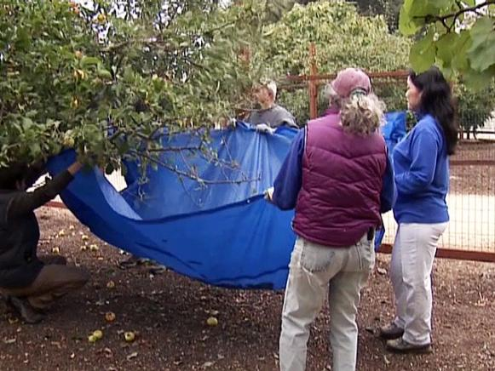
EXISTING METHODS
1.Shake the limb and the fruit falls off
In this technique, we have to shake the limb of the tree, the fruit falls down.
In this method lots of Human work is required.

Slide 5
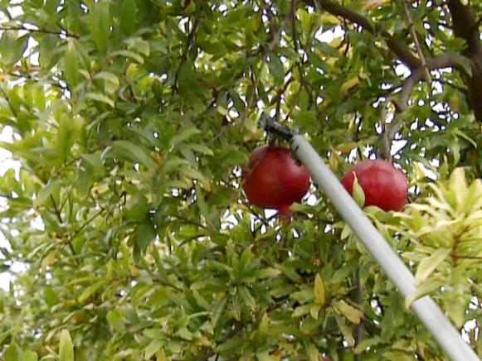
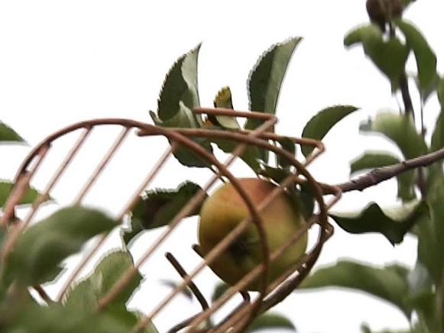
2. Twist and pull method
In this method, lot of time is taken to grab each individual fruit and twist it until the fruit is free of the tree.
3. Use a fruit picker basket
In this method it is hard to reach the fruit to pull from the stem .

Slide 6

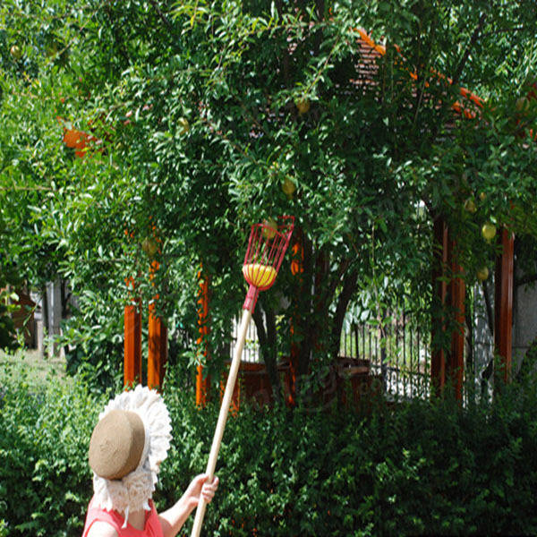
DISADVANTAGES
Lot of time consuming process.
Shortage of seasonal labors
In general, through manual work fruits are getting damaged.

Slide 7
PROPOSED METHOD
To overcome all the problems of manual work we come up with harvesting robot
STEP:1 Interfacing Arduino Uno with color detecting sensor to detect the color of the fruit.
STEP:2 Interfacing Arduino Uno with Servomotors to control the function of robotic arm.
STEP:3 Interfacing Arduino Uno with dc motors for robot movements (Left, Right, Forward & Backward).

Slide 8
BLOCK DIAGRAM
External Power
(NiMH Battery)
Robotic Arm
ARDUINO UNO ATmega 328
Color Detection Sensor
(TCS3200)
2 Servo Motors
DC motors

Slide 9
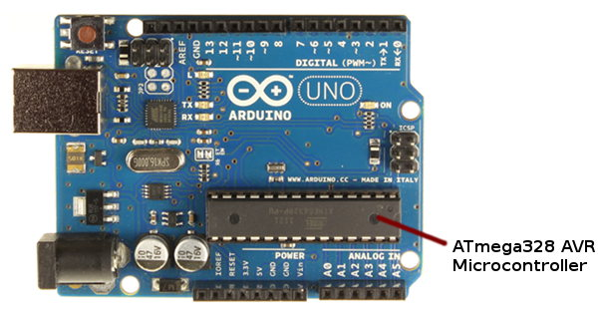
ARDUINO UNO 328
The Arduino Uno is a microcontroller board based on the ATmega328.
Arduino Uno is used to create user Interface Environment(IDE).
We connect it to a computer with a USB cable or power it with a AC-to-DC adapter or battery to get started.
The power pins are as follows:
1.Vin
2.5V
3. 3.3V
4.GND

Slide 10
Technical Specifications
Operating Voltage | 5V
Input Voltage(recommended) | 7-12V
Input Voltage(limits) | 6-20V
Digital I/O Pins | 14
Analog I/O Pins | 6
DC Current per I/O Pins | 40 mA
DC Current for 3.3V Pin | 50mA
Flash Memory | 32 KB
SRAM | 2 KB
EEPROM | 1 KB
Clock Speed | 16 MHz

Slide 11
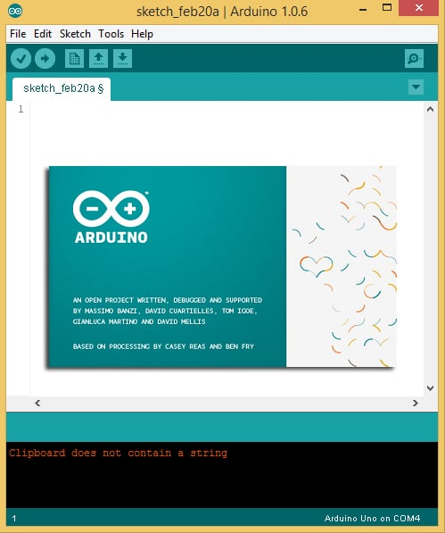
Functions used in Arduino UNO
#define S0 9
#include<Servo.h>
PinMode(pin number, OUTPUT);
digitalWrite(pin number, HIGH/LOW);
delay(1000);
Serial.begin(9600);
Serial.print(“RED”);

Slide 12
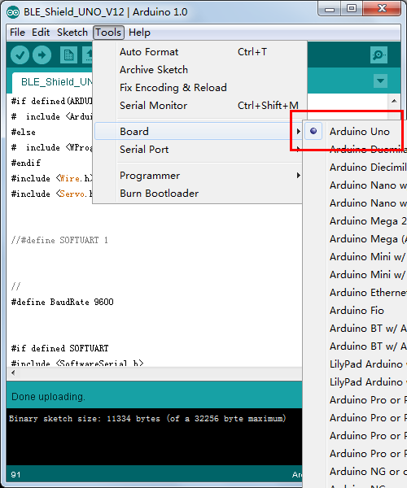
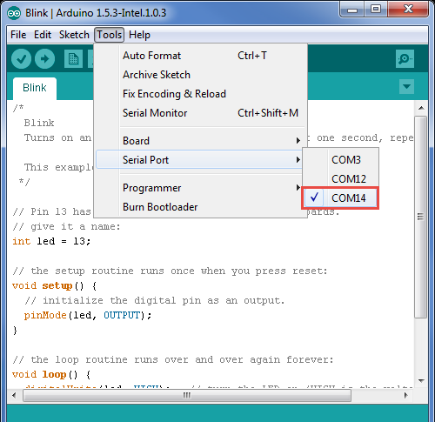
Library inclusion
Board selection

Slide 13
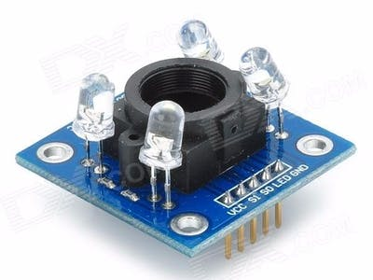
Color Detection Sensor
This is a simple color sensor using Arduino Uno R3 and TCS3200 color sensor module.
It is useful for color identification and detection.
It is used for detecting primary colors (red, green and blue) that are physically available in LEDs in one package.

Slide 14
Interfacing Arduino UNO with Color Detection Sensor
Interfacing of TCS3200 color sensor with Arduino UNO for color detecting the fruits.
TCS3200 color sensor contains 8x8 array of photodiodes.
In this 16 of Red photodiodes,16 of Green photodiodes ,16 of Blue photodiodes and another 16 for clear filters.
This photodiodes are used to detect colors.
In this we have written embeded-C programm for color detection sensor using Arduino IDE. It will detect colors of RGB.

Slide 15
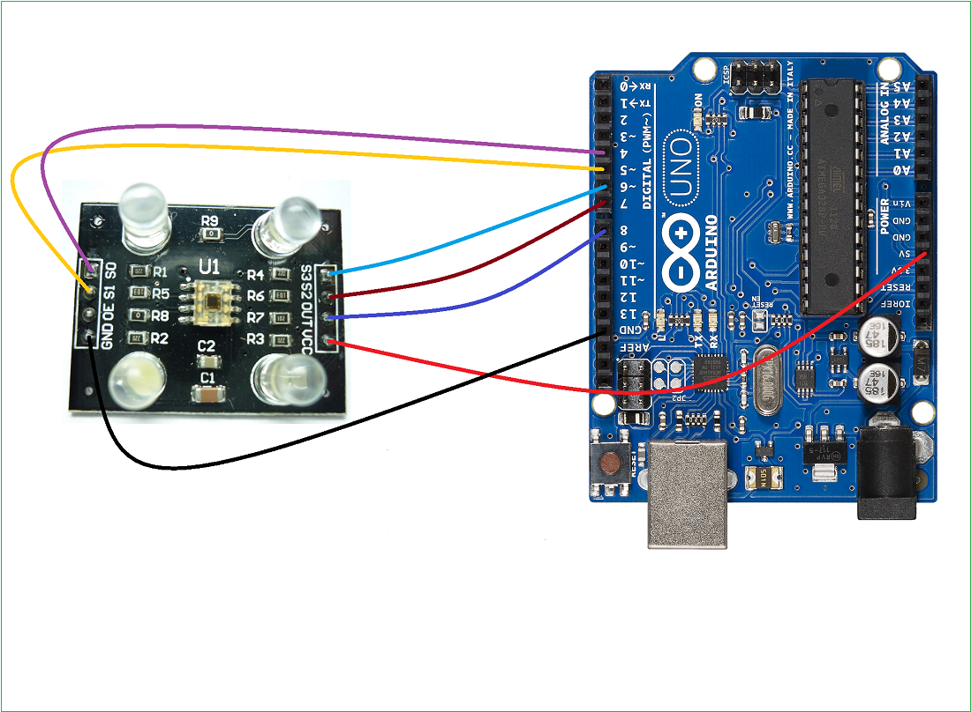
Interfacing of Arduino Uno & TCS 3200 color sensor

Slide 16
Interfacing Connections
Color detection sensor pins | Arduino uno pins
S0 pin is connected to | To the digital pin D4
S1 pin is connected to | To the digital pin D5
S2 pin is connected to | To the digital pin D7
S3 pin is connected to | To the digital pin D6
Vcc pin is connected to | 5V
GND pin is connected to | GND
Out pin is connected to | To the digital pin D6
OE pin is connected to | GND

Slide 17
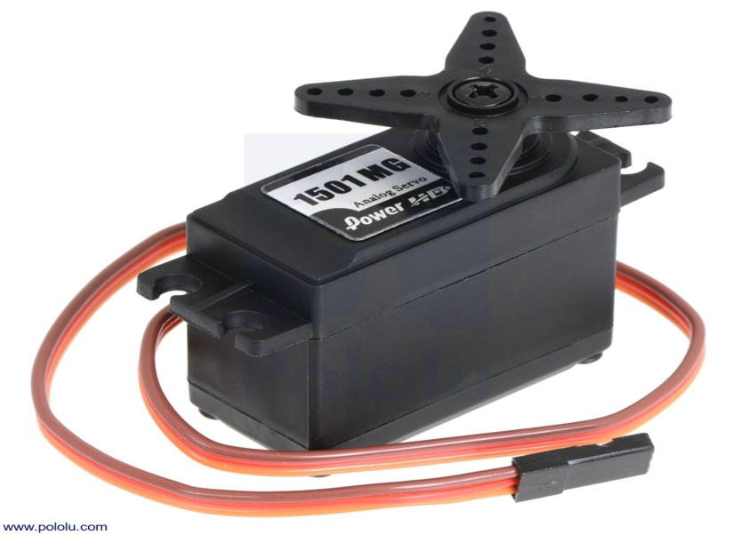
Servo Motor
A servomotor is a rotary actuator which allows for precise control of position in angular direction.
In servo motor, a small setup of a DC motor, potentiometer and control circuit is present.

Slide 18
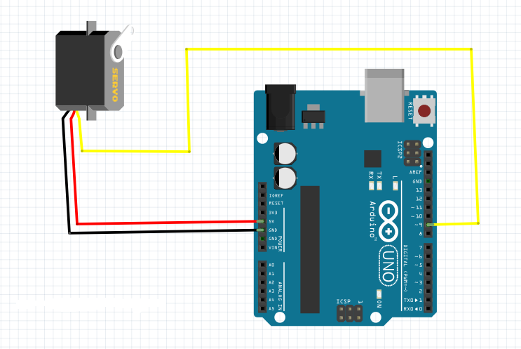
Interfacing servo motors with Arduino UNO
By interfacing servomotors with Arduino UNO, we are going to control robotic arm operation.
Servo Motors are used where there is a need for accurate shaft movement or position.
The position of the shaft of the DC motor is adjusted by the control electronics in the servo, based on the duty ratio of the PWM signal.

Slide 19
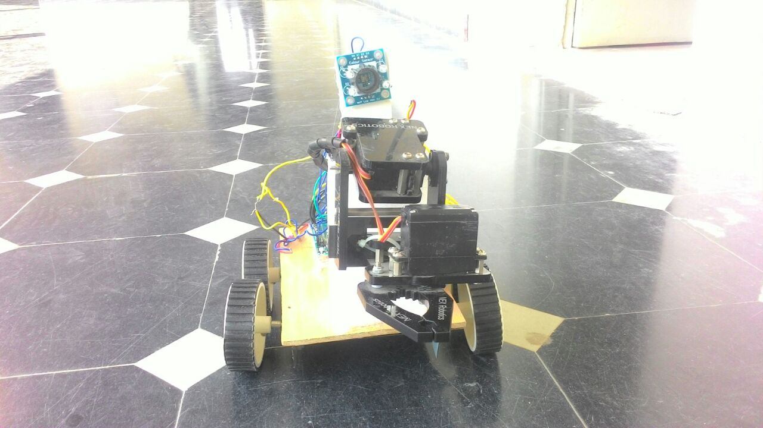
In the harvesting robot we are going to interface two servo motors.
One servomotor is used to raise the robotic arm vertically upwards.
Another servo motor is used for gripping action.

Slide 20
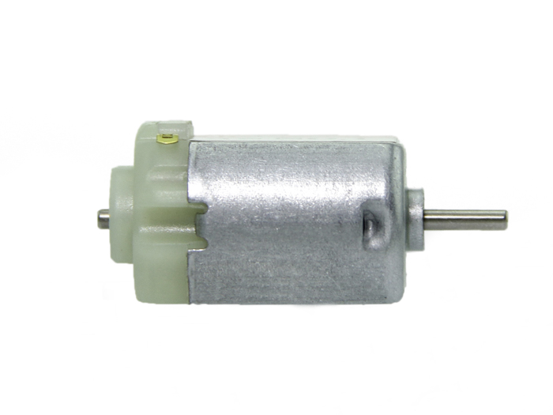
DC MOTOR
A dc motor is an electrical machine which converts direct electrical energy into mechanical energy.
dc motor’s speed is controlled by using the variable supplied voltage or by changing the Strength of current in the field windings.

Slide 21
Interfacing dc motor to the Arduino UNO
The dc motors controlled by arduino to rotate the wheels of the robot.
The arduino is programmed to turn the robot left,right movements.

Slide 22
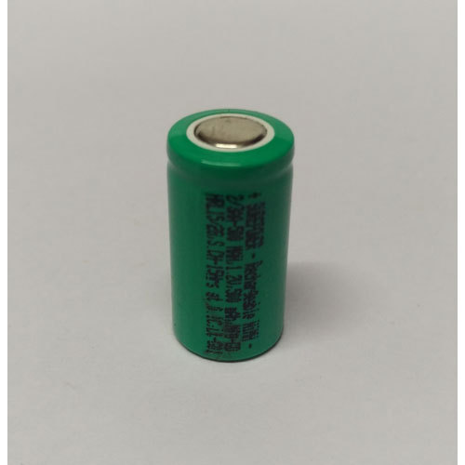
External power(NiMH Battery)
A nickel–metal hydride battery is a rechargable battery.
NiMH cells are often used in digital cameras.
NiMH cells are advantageous for high-current-drain applications, largely due to their lower internal resistance.
9.6V is provided by Nickel Metal Hydride (NiMH) battery.

Slide 23
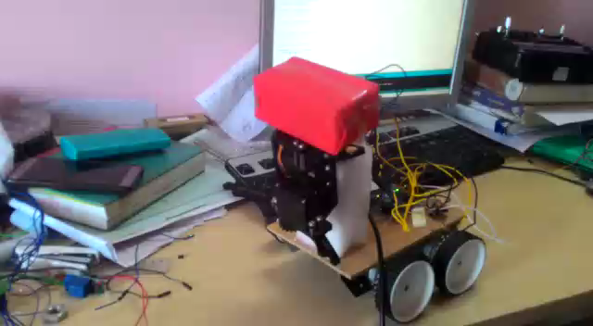
Results:

Slide 24
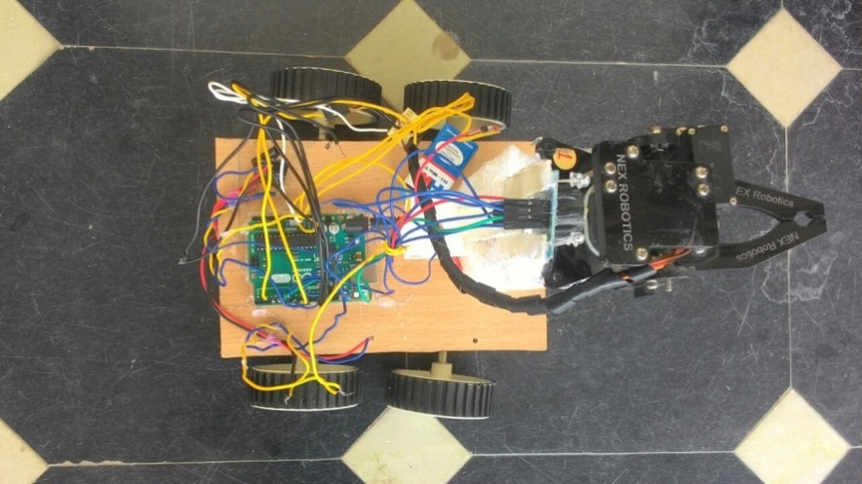
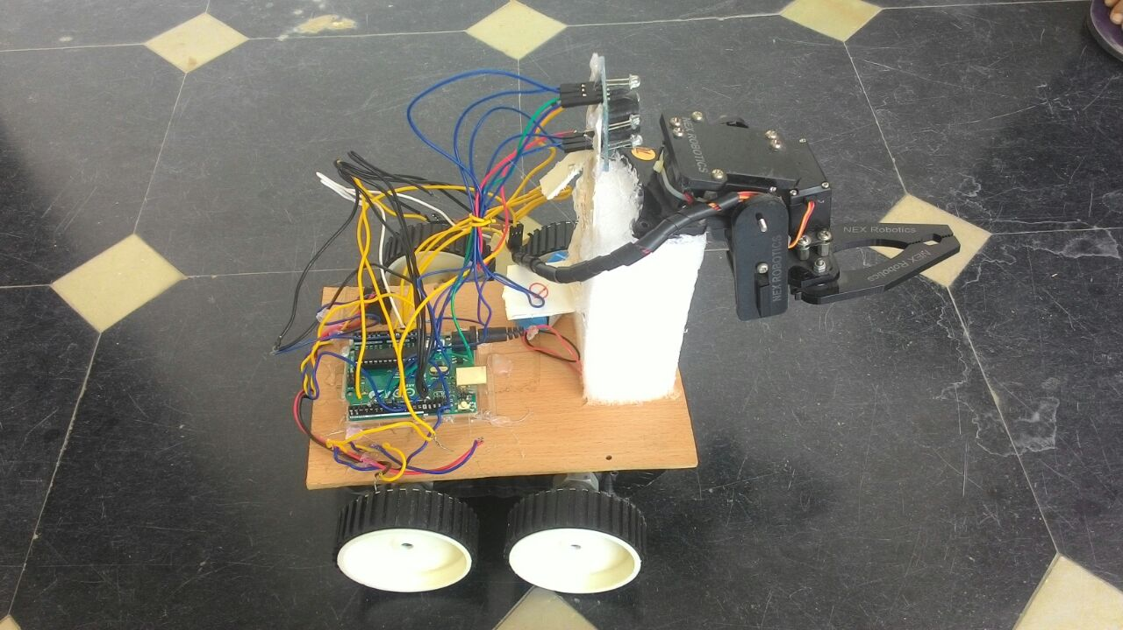
Front view
Top view
Side view

Slide 25
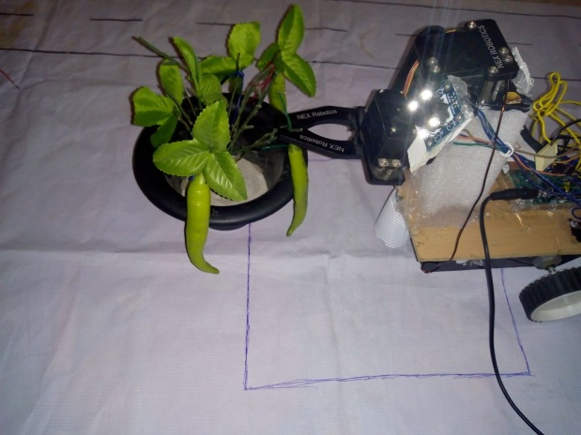
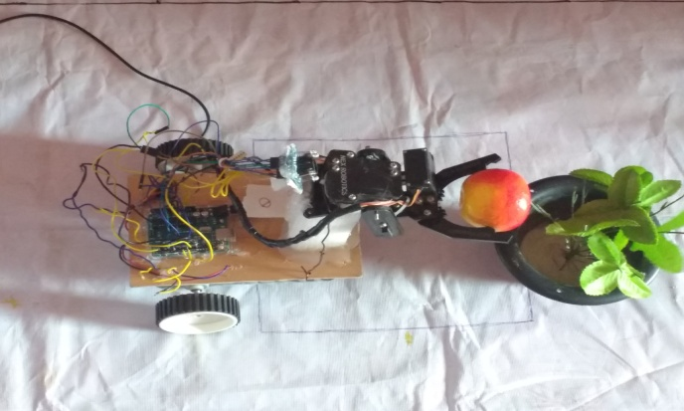
Gripping action of the robot
Robot plucks the fruit from the tree when it senses the RGB color.
The gripping action of the robot depends upon the object (fruit, vegetable) color intensity.
Robot plucking the chilly
Robot plucking the fruit

Slide 26
Advantages
Automatically harvest the fruits without involvement of humans.
Speed up the process of harvesting compared to manual work.
It will work in any environment condition like fog,high temperature.

Slide 27
Disadvantages
It plucks only the primary color (RGB) fruits or vegetables.
It does not pluck the exact ripen fruit.
Color sensor is not accurate in detecting colors

Slide 28
CONCLUSION
We implemented harvesting robot prototype which can automatically pluck the fruit from the tree without intervention of human.
This robot is applicable in harvesting fruits or vegetables.

Slide 29
Future Scope
By Performing digital color image analysis there is an advancement for harvesting robots to pluck the exact ripen fruit using digital cameras.

Slide 30
References
www.safaribooksonline.com/library/view/arduino-a-technical/9781491934319/
www.dfrobot.com/wiki/index.php/TCS3200_Color_Sensor_(SKU:SEN010)
howtomechatronics.com/tutorials/arduino/arduino-color-sensing-tutorial-tcs230-tcs3200-color-sensor/
https://www.jameco.com/jameco/workshop/howitworks/how-servo-motors-work.html
https://www.theengineeringprojects.com/2017/05/servo-motor-control-using-arduino.html
8051 Microcontroller-Internals, Instructions, Programming & Interfacing by Subrata Ghoshal

Slide 31
Any Queries ?

Slide 32
Thank You

